Slide 1
5篇论文
名称 | 期刊/会议
基于信息检索的软件缺陷定位方法综述 | 软件学报
Learning to Combine Multiple Ranking Metrics for Fault Localization | ICSME
What makes a good bug report? | TSE
Improving bug localization with word embedding and enhanced convolutional neural networks | IST
Improved bug localization based on code change histories and bug reports | IST

Slide 2


What Makes a Good Bug Report？
汇报人：王昭丹

Slide 3

CONTENTS
01. INTRODUCTION
02. SURVEY DESIGN & RESULTS
03. RATING BUG REPORTS
04. MEASURING BUG REPORT QUALITY

Slide 4
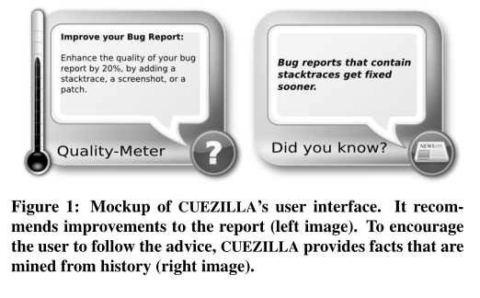
INTRODUCTION
In software development, bug reports provide crucial information to developers.
Bug reports vary in their quality of content; they often provide inadequate or incorrect information.
CUEZILLA TOOL
Length of descriptions
Formatting
Stack traces
Attachments
Examples
“Sem Web” (APACHE bug COCOON-1254)
“wqqwqw” (ECLIPSE bug #145133)
“GUI” with comment “The page is too clumsy” (MOZILLA bug #109242)

Slide 5
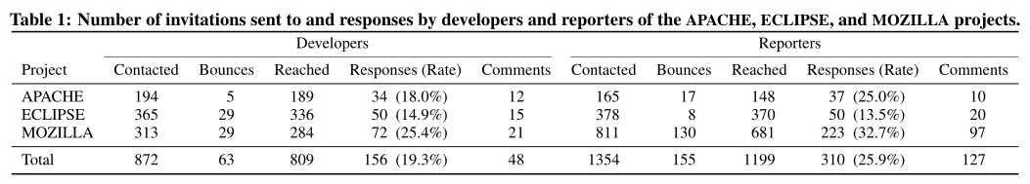
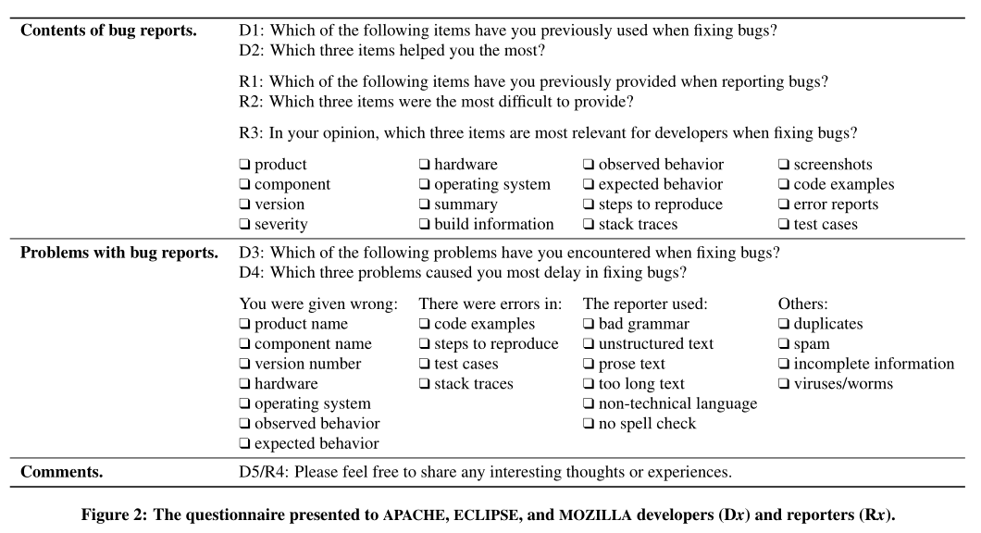
SURVEY DESIGN
Selection of Participants
experienced developers —— at least 50 bug reports
experienced reporters —— at least 25 bug reports (=a user) zero bugs (=not a developer)
The Questionnaire

Slide 6
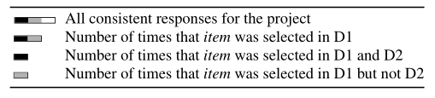
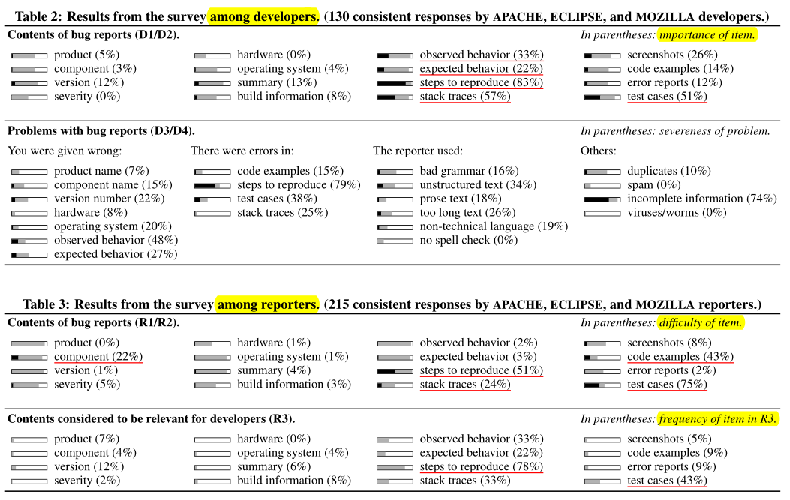
SURVEY RESULTS
Steps to reproduce
Observed and expected behavior

Slide 7
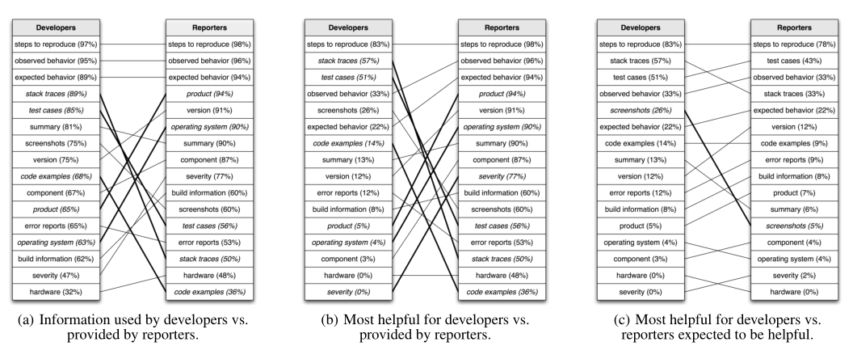
SURVEY RESULTS
Mismatch between what developers consider most helpful and what users provide !

Slide 8
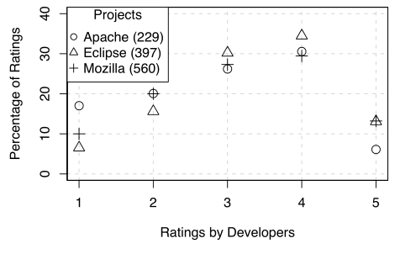
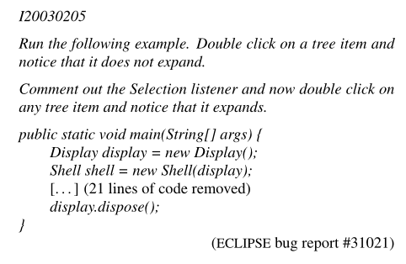
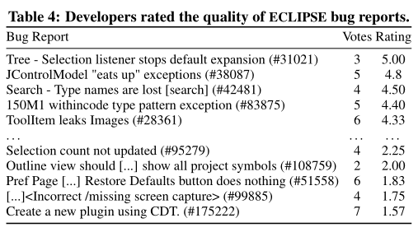
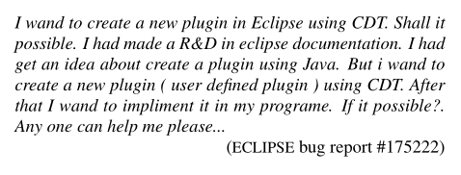
RATING BUG REPORTS
√
×

Slide 9
MEASURING BUG REPORT QUALITY
How CUEZILLA works ?
Represents each bug
report as a feature vector
Uses supervised learning to train models
Measure the quality of bug reports

Slide 10


Input Features
Itemizations
itemization character
(such as -,*, or +).
Keyword
completeness
reused the dataset by Andy Ko
quality-score of bug reports
island parsing
recognize declarations, comments, conditional statements, and loops
JAVA stack traces
GDB stack traces
MOZILLA talkback data
Code Samples
Stack Traces
Patches
regular expressions
several start lines and blocks
Screenshots
File tool in UNIX
Image —— screenshot
Text —— code examples, stack traces, and patches

Slide 11
Input Features
Use the style tool
The readability of a text is measured by the number of syllables per word and the length of sentences.
The higher a readability score, the more complex a text is to read.
Seven readability measures: Kincaid, Automated Readability Index (ARI), Coleman-Liau, Flesh, Fog, Lix, and SMOG Grade
Readability

Slide 12
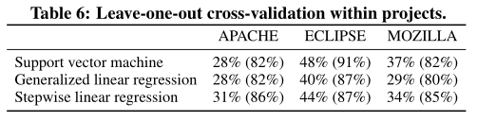
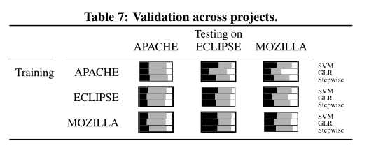

two setups
Evaluation Setup
support vector machines (SVM)
generalized linear regression (GLR)
stepwise linear regression
Within project
Across projects
Three Models
leave-one-out cross-validation technique
Maximize training data
Test if models from one project can be transferred to others
1
2

Slide 13
学习进展&暑期计划
感谢您的聆听
汇报人：王昭丹

